Slide 1
Enhancements
May 11, 2015
|EOS~001|
Notes:
|EON~001|
Guidewire training materials contain Guidewire proprietary information that is subject to confidentiality and non-disclosure agreements. You agree to use the information in this manual solely for the purpose of training to implement Guidewire software solutions. You also agree not to disclose the information in this manual to third parties or copy this manual without prior written consent from Guidewire. Guidewire training may be given only by Guidewire employees or certified Guidewire partners under the appropriate agreement with Guidewire.
<number>

Slide 2
Describe the purpose and functionality of Gosu enhancements
Create entity enhancements
Reference entity enhancement properties and methods
Create Gosu enhancements for Java classes and interfaces
Debug enhancements
|EOS~002|
Notes:
|EON~002|
<number>

Slide 3
Entity enhancement fundamentals
Creating entity enhancements
Referencing enhancement properties and methods
Debugging enhancements
Gosu enhancements for Java
|EOS~003|
Notes:
|EON~003|
<number>

Slide 4
Gosu Enhancements
A Gosu enhancement is code that enhances the functionality of an existing type
Configuration developers enhance entity types and some Java classes
For entity types, add properties and methods
For Java classes, extend functionality of a base type
Lesson focuses on enhancements for entities and Java classes
|EOS~004|
Notes:
|EON~004|
Guidewire types that can be enhanced include entities, Java classes, permissions, and SOAP entities. A fundamental reason for enhancing an entity is to add behaviors to a type that would not be appropriate to do by creating a subtype.
<number>

Slide 5
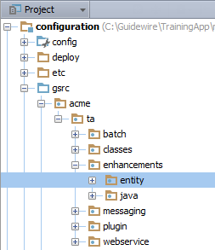
Packages
Enhancements reside in packages
Packages organize Gosu code files for
Related logic
Access among classes
Packages are hierarchal
Creates one unique fully qualified name
…\configuration\gsrc\
Create packages in gsrc
Package naming convention:
<company>.<app-abbrv>.<mechanism>.<functional_area>
|EOS~005|
Notes:
|EON~005|
A package contains classes, enhancements, and other types of Gosu code files. A package is an aspect of object oriented programming languages and represents a collection of grouped code files. Often, the files in a package have a similar function or related purpose.
For the Acme's customer implementation of TrainingApp, packages are created in the acme.ta. package. In the slide example, the naming convention for packages for entity enhancements is acme.ta.enhancements.entity.
<company> is the company's name or a suitable abbreviation.
<app-abbrv> is the Guidewire application's two-letter abbreviation, for example PolicyCenter is pc, BillingCenter is bc, ClaimCenter is cc, ContactManager is ab or cm.
<mechanism> can be enhancements, batch, messaging, plugin (for predefined non-messaging, non-startable plugins), startable, webservice, or class(es)
<functional_area> is the functional area of the application.
<number>

Slide 6
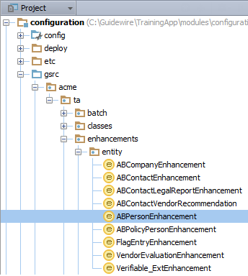
Enhancement files
.gsx files
Always in a package
Guidewire code found in
…\configuration\gsrc\
Create customer enhancements in packages related to the customer implementation
Example:
acme.ta.enhancements.entity.ABPersonEnhancement
|EOS~006|
Notes:
|EON~006|
A package can contain any number of enhancements and Gosu code files. In many Guidewire applications, you can find enhancements in the …\gsrc\libraries\ package and in …\gsrc\gw\ sub-packages.
For the Acme's customer implementation of TrainingApp, enhancements are created in the acme.ta.enhancements package.
In the slide example, the ABPersonEnhancement file is in the hierarchy of the acme package. The fully qualified name is acme.ta.enhancements.entity.ABPersonEnhancement.
You reference an enhancement in a package with a fully qualified name. A fully qualified name details the package hierarchy. Per package hierarchy, you can only have one unique name.
<number>

Slide 7
Enhancement for a given type
1 var anABPerson= ta.QueryUtil.findPerson("ab:5") 2 print("Birth date: " + anABPerson.DateOfBirth) 3 print("Age: " + anABPerson.Age )
ABPersonEnhancement.gsx
Enhancement contains code the enhances a specific type
Example:
Age is an ABPerson enhancement property and uses the DateOfBirth field to calculate the age
|EOS~007|
Notes:
|EON~007|
In the slide example, ABPersonEnhancement.gsx is the enhancement file that enhances the ABPerson entity with an Age property. The property is available to any ABPerson or any object that is a subtype of ABPerson such as ABDoctor.
<number>

Slide 8
Enhancement components
Getter properties
Setter properties
Methods
Calculate derived values
Set field values that require additional logic
Take input parameters, and/or
Modify other objects, and/or
Create objects
|EOS~008|
Notes:
|EON~008|
Enhancements can have any number of the following: getters, setters, and methods.
<number>

Slide 9
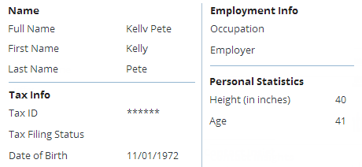
Enhancements to get values
Derived values should NOT be stored in the database
ABPersonEnhancement.gsx enhances ABPerson entity
Defines the Age property getter
Property calculates age based on the date of birth value
|EOS~009|
Notes:
|EON~009|
In the slide example, ABPersonEnhancement.gsx is the enhancement file that extends the ABPerson entity with an Age property.
<number>

Slide 10
Getter properties
A getter property is used to calculate a derived value
Property not declared at data model level
Value not stored in database
Code cannot receive input parameters
Code can only returns a value
Should not be used to alter any data
Null safe
Example: ABPerson.Age
Derive value by calculating number of years between date of birth and current date
Returns "Unknown" if date of birth is null
Storing Age in database is redundant
|EOS~010|
Notes:
|EON~010|
A getter is appropriate when you can derive a value and the derived value does not need to be stored in the database. In the slide example, ABPersonEnhancement.gsx is the enhancement file that extends the ABPerson entity with an Age property.
<number>

Slide 11
Example getter: ABPerson.Age
7 enhancement ABPersonEnhancement: entity.ABPerson {
…27 property get Age(): String { 28 if (this.DateOfBirth == null) { 29 return "Unknown"
30 } else { 31 var today = DateUtil.currentDate() 32 var ageInDays = DateUtil.daysBetween(this.DateOfBirth, today) 33 var ageInYears = Math.roundDown(ageInDays / 365) 34 return ageInYears as java.lang.String 35 } 36 } …85 }
Line 7: Enhancement declaration identifies the type to enhance
Keyword this represents the object from which to call the enhancement property
|EOS~011|
Notes:
|EON~011|
For all enhancement logic, the this keyword represents the object from which the getter, setter, or method is called.
In the slide example, ABPersonEnhancement.gsx is the enhancement file that extends the ABPerson entity with an Age property. Line 7 declares the type to enhance.
<number>

Slide 12
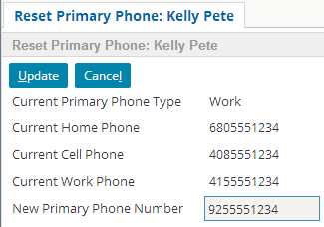
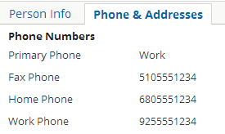
Enhancements to set values
ABPersonEnhancement.gsx enhances ABPerson entity
Use setters to modify values for calling object
Setter determines which phone field to update using the primary phone typekey for an ABPerson object
|EOS~012|
Notes:
|EON~012|
In the slide example, work is the primary phone typekey for the contact. The new number will update the work phone field rather than the cell, fax, or home phone fields. ResetPrimaryPhoneWorksheet.pcf contains the setter reference.
In the slide example, ABPersonEnhancement.gsx is the enhancement file that extends the ABPerson entity with the NewPrimaryPhone setter property.
<number>

Slide 13
Setter property
A setter property takes a single input value and uses it to modify the associated object
Property not declared at data model level
Value given to setter may or may not be stored in database
Values manipulated by setter are typically stored in database
Code must receive exactly one input parameter
Should not be used to alter other objects
Example: ABPolicyPerson.HeightInInches(arg)
Getter takes height from database (in meters) and converts it to inches (so, for example, it can be displayed in UI)
Setter takes height (in inches) and converts it to meters before saving it to database
|EOS~013|
Notes:
|EON~013|
An implementation of any Guidewire application will have a small number of setters because of the limiting criteria for use. A setter is appropriate only when you need to set one or more fields based on a single input value and—if there is a single field to be set—it is a field that cannot be set by simply assigning the input value to the field.
Possible use cases for setters could include:
Adding a value to one field out of several possible fields (such as adding a new phone number to either Work Phone, Home Phone, or Cell Phone).
Adding an object to an array and making that value the primary object (such as adding a new employee to an ABCompany and making that employee the primary contact).
Adding a value to a field that must be converted to a different unit (such as receiving a dollar amount in Euros but needing to store that amount as dollars).
Converting an integer value to a typekey value (such as receiving an integer that represents the number of employees and using that to set a CompanySize typekey value which could be: Under 100, 101 to 500, 501 to 1000, Over 1000).
In the slide example, ABPolicyPersonEnhancement.gsx is the enhancement file that extends the ABPolicyPerson entity with the HeightInInches setter property.
<number>

Slide 14
Example setter
7 enhancement ABPersonEnhancement: entity.ABPerson {
…44 property set NewPrimaryPhone(newPhoneNumber: String) {
45 if (this.PrimaryPhone == typekey.PrimaryPhoneType.TC_HOME) {
46 this.HomePhone = newPhoneNumber 47 }
48 if (this.PrimaryPhone == typekey.PrimaryPhoneType.TC_WORK) {
49 this.WorkPhone = newPhoneNumber 50 }
51 if (this.PrimaryPhone == typekey.PrimaryPhoneType.TC_MOBILE) {
52 this.CellPhone = newPhoneNumber
53 }
54 } …69 }
Must receive exactly one value, which is value to set
Keyword this represents the object from which to call the property
|EOS~014|
Notes:
|EON~014|
For all enhancement logic, the this keyword represents the object from which the getter, setter, or method is called.
In the slide example, ABPersonEnhancement.gsx is the enhancement file that extends the ABPerson entity with an NewPrimaryPhone setter property. Line 7 declares the type to enhance.
<number>

Slide 15
Enhancement methods
A method is a set of statements that executes a logical unit of work
Can receive any number of parameters
Can optionally return a value
Create when your code…
Requires multiple input parameters, and/or
Modifies multiple unrelated fields on given object, and/or
Creates or modifies other objects, and/or
Does not "feel like" a setter
Example: ABPerson.createWorkByOccupation()
ABPersonEnhancement.gsx enhances ABPerson entity
Uses information known about object to assign employer
|EOS~015|
Notes:
|EON~015|
There are two elements that alter data: setters and methods. Each is appropriate under different circumstances.
A setter is appropriate when you are making a change to the object, the change "feels like" you are setting a field, a single input value is used to determine how to set the value, and no other objects get changed. An example of a setter is Contact.PrimaryAddress(anAddress). The setter adds anAddress to the contact's array of addresses (if necessary) and then sets that address to be the primary address.
A method is appropriate when you need to make a change and either the change doesn't feel like you are setting a field, you need multiple parameters, and/or there are changes that include other objects An example of a method is Contact.CreateFraudCase(Reason). The method creates an activity associated to the contact and creates a note associated to the activity that includes the Reason in the note body.
<number>

Slide 16
Example method (1)
7 enhancement ABPersonEnhancement: entity.ABPerson {
…64 function assignDefaultOccupation(): void { 65 if (this.Occupation == null) { 66 if (this.Subtype == typekey.ABContact.TC_ABATTORNEY) { 67 this.Occupation = "Attorney" 68 } else {
69 if (this.Subtype == typekey.ABContact.TC_ABDOCTOR) { 70 this.Occupation = "Doctor" 71 } else {
72 if (this.Employer != null) { 73 this.Occupation = "Employee of " + this.Employer.Name 74 } else {
75 this.Occupation = "Unknown"
76 }
77 }
78 }
79 }
…81 }
…86 }
Keyword this represents the object from which to call the property
|EOS~016|
Notes:
|EON~016|
For all enhancement logic, the this keyword represents the object from which the getter, setter, or method is called.
In the slide example, ABPersonEnhancement.gsx defines the assignDefaultOccupation() enhancement method.
<number>

Slide 17
Example method (2)
5 enhancement ABContactEnhancement: entity.ABContact {
…88 function addContactNote(): ContactNote { 89 var newContactNote = new ContactNote() 90 this.addToContactNotes(newContactNote) 91 return newContactNote 92 } …111 }
Create a new instance of an entity (object) in method and relate the new object to an existing object
Set one object's foreign key to the other object (harder)
Add the new object to an existing array (easy)
Example:
Line 5: Declares the type to enhance
Line 88: Declare method
Line 89: Creates new object
Line 90: Adds new object to the object that called the method with the this keyword
|EOS~017|
Notes:
|EON~017|
In the slide example, ABContactEnhancement.gsx defines the addContactNote() enhancement method for the ABContact entity. Line 5 declares the type to enhance.
<number>

Slide 18
Entity enhancement fundamentals
Creating entity enhancements
Referencing enhancement properties and methods
Debugging enhancements
Gosu enhancements for Java
|EOS~018|
Notes:
|EON~018|
<number>

Slide 19
Steps to create an enhancement
[Optional] Create a new package
Create a new enhancement file
Code getter properties, setter properties, methods
Deploy the enhancement
|EOS~019|
Notes:
|EON~019|
<number>

Slide 20
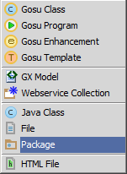
Step 1: [Optional] Create a package
In Project View, select gsrc or an existing package in …\configuration\gsrc\
Context menu → New → Package
Enter the package name
Use dot notation to create a package hierarchy
<company>.<app_code>.enhancements.<functional_area>
|EOS~020|
Notes:
|EON~020|
In the slide example, the package name – acme.ta.enhancements.entity – represents a customer implmentation of a package hierarchy in TrainingApp. Packages are always arranged in a hierarchy. When naming a package, the package name must be unique for the given parent package or \gsrc folder. Package names should always be entirely in lower case. Never create child packages in com.guidewire or gw packages.
You create customer enhancements in packages related to your customer implementation.
The package hiearchy represents the recommended naming convention of <company>.<app_code>.<mechanism>.<functional_area> as follows:
For <company>, the name is acme.
For <app_code>, the name is ta.
For <mechanism>, the name is enhancements.
For <functional_area>, the name is entity as the customer is creating an entity enhancement.
<number>

Slide 21
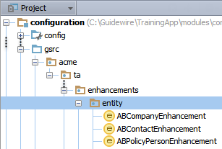
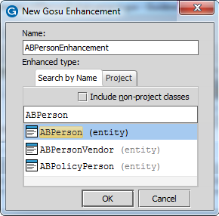
Step 2: Create an enhancement file
In Project View, select a package
Context menu → New → Gosu Enhancement
Enter the name in Pascal Case
<EntityName> + <AdditionalTextWhenNeeded> + Enhancement
Select entity in dialog
|EOS~021|
Notes:
|EON~021|
Guidewire recommends that you create an enhancement in a custom package hierarchy named after your company using the package naming convention of <company>.<app_code>.<mechanism>.<functional_area>. The recommended naming convention for an enhancements is: <EntityName> + <AdditionalTextWhenNeeded> + Enhancement. For the name, use Pascal case. In Pascal case, the first letter in the identifier and the first letter of each subsequent concatenated word are capitalized. In the slide example, the fully qualified name for the enhancement is acme.ta.enhancements.entity.ABPersonEnhancement. The fully qualified name consists of the package hierarchy and the enhancement names.
In the slide example, the ABPersonEnhancement name does not have the <AdditioanlTextWhenNeeded> name component. In some cases, you may need to have multiple enhancements for a single entity. Use the <AdditionalTextWhenNeeded> to specify the difference between the enhancements. For example, the PolicyPeriod entity in Guidewire PolicyCenter has the following enhancement files:
PolicyPeriodAuditEnhancement
PolicyPeriodBaseEnhancement
PolicyPeriodFormsEnhancement
PolicyPeriodOfferingEnhancement
PolicyPeriodSideBySideEnhancement
PolicyPeriodSummaryEnhancement
<number>

Slide 22
Step 3: Code getters
1 property get PropertyName() : returnType {
2 // code to return derive property 3 return this.propertyValue as returnType 4 }
Both getter and setter should use the same property name
For properties, use Pascal case
Capitalize the first letter in the identifier and the first letter of each subsequent concatenated word
|EOS~022|
Notes:
|EON~022|
Guidewire recommends that the property name should be in Pascal case. Pascal case is a style of capitalization in which multiple words are joined together with the first character of each word capitalized. Examples include the names "ClaimCenter" and "JavaScript".
You can precede the property keyword with one or more modifier keywords. Guidewire modifiers include public and private, which are access modifiers. A property is public by default, meaning that it can be referenced from anywhere in a Guidewire application that uses Gosu.
In contrast, a private property can be referenced only within the library in which it is defined. Because the public keyword is optional, it has been omitted in the slide example.
For more information about modifiers, see the Gosu Reference Guide.
<number>

Slide 23
Step 3: Code setters
1 property set PropertyName(parameter : dataType) {
2 // code to set property with a value
3 var newValue = parameter + parameter
4 this.propertyValue = newValue 5 }
Both getter and setter should use the same property name
For properties, use Pascal case
Capitalize the first letter in the identifier and the first letter of each subsequent concatenated word
|EOS~023|
Notes:
|EON~023|
Guidewire recommends that the property name should be in Pascal case. Pascal case is a style of capitalization in which multiple words are joined together with the first character of each word capitalized. Examples include the names "ClaimCenter" and "JavaScript".
You can precede the property keyword with one or more modifier keywords. Guidewire modifiers include public and private, which are access modifiers. A property is public by default, meaning that it can be referenced from anywhere in a Guidewire application that uses Gosu.
In contrast, a private property can be referenced only within the library in which it is defined. Because the public keyword is optional, it has been omitted in the slide example.
For more information about modifiers, see the Gosu Reference Guide.
<number>

Slide 24
Step 3: Code methods
1 function functionName(parameter : dataType) : returnType {
2 // code to execute method
3 if (parameter == someValue) {
4 this.propertyValue = doSomething(parameter) 5 } else {
6 this.propertyValue = doSomethingElse(parmeter) 7 }
8 return returnType
9 }
Return any type of value available in Gosu
Boolean, String, Integer
Void means nothing to return; no return statement required
For methods, use Camel Case
The first letter in the identifier is lower case
Capitalize the first letter of each subsequent concatenated word
|EOS~024|
Notes:
|EON~024|
The recommended capitalization convention for methods is to use Camel Case. In Camel Case, the first letter of an identifier is lowercase and the first letter of each subsequent concatenated word is capitalized. Examples include popupButtonText, calculateAvailability, or assignToNextAvailableUser.
A method can return any type of value available in Gosu, including Boolean, String, and Integer.
Like the property keyword, you can precede the function keyword with one or more modifier keywords. Guidewire modifiers include public and private, which are access modifiers. A method is public by default, meaning that it can be referenced from anywhere in a Guidewire application that uses Gosu.
In object-oriented languages such as Gosu, you can create overload a method in the same class. Overloading means creating multiple methods with the same name and the same return type, but each method signature has a different number of input parameters and/or different data types.
If editing a base entity enhancement, only to create new methods. Do not to overload existing methods that exist already within the application.
<number>

Slide 25
Step 4: Deploy package and enhancement *New*
Restart Server
New package and enhancement loaded at server startup
Package
Enhancement (.gsx)
|EOS~025|
Notes:
|EON~025|
If the new enhancement exists in a new package, then you must restart the server to deploy the enhancement.
If the enhancement is new but exists in an previously deployed package that contains Gosu code, then the enhancement is considered to be a modified enhancement.
<number>

Slide 26
Step 4: Deploy enhancements *Modified*
Reload changed classes
Compile classes
Main Menu → Run → Reload Changed Classes
Main Menu → Build → Compile
CTRL+SHIFT+F9
Enhancement (.gsx)
Enhancement (.gsx)
|EOS~026|
Notes:
|EON~026|
You can deploy modified enhancements when the server is running in run or debug server process. If the enhancement is new but exists in an previously deployed package that contains Gosu code, then you can also deploy the new enhancement that is the previously deployed package when the server is running in run or debug server process. In both cases, you can reload changed classes or compile the class.
If the enhancement exists in a new package, then you must restart the server to deploy the enhancement.
If your modified enhancement (.gsx) contains a new displaykey, then you will also need to reload PCF files using ALT+SHIFT+L, the Guidewire API and/or internal server tools.
<number>

Slide 27
Entity enhancement fundamentals
Creating entity enhancements
Referencing enhancement properties and methods
Debugging enhancements
Gosu enhancements for Java
|EOS~027|
Notes:
|EON~027|
<number>

Slide 28
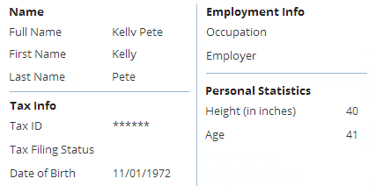
Reference enhancement get
Reference getters using the same syntax as fields and other derived properties
Value property of input widget references the getter
Age getter specifies the value of the Age widget
|EOS~028|
Notes:
|EON~028|
Entity enhancement elements are referenced using the same syntax as base application entity elements. In the slide example, ABPersonEnhancement.gsx defines the Age property. The getter calculates the age using the date of birth date value.
<number>

Slide 29
Reference enhancement set
Reference setters using the same syntax as fields
beforeCommit property of the worksheet location references the NewPrimaryPhone setter
|EOS~029|
Notes:
|EON~029|
Entity enhancement elements are referenced using the same syntax as base application entity elements. In the slide example, ABPersonEnhancement.gsx defines the NewPrimaryPhone setter enhancement property. The setter updates the number per the type PrimaryPhone type key prior to committing the data to the database.
<number>

Slide 30
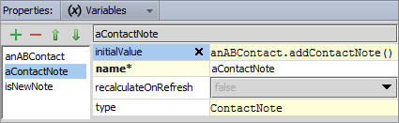
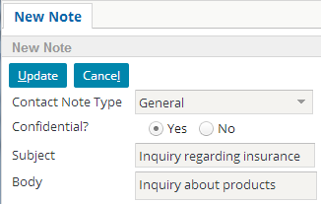
Reference enhancement method
Reference methods using the same syntax as object methods
Worksheet location variable initialValue property creates a new Contact Note using the addContactNote() method
|EOS~030|
Notes:
|EON~030|
Entity enhancement elements are referenced using the same syntax as base application entity elements. The addContactNote method is used to create a new, empty contact note related to anABContact. You can find the method referenced in ContactNoteWorksheet.pcf
<number>

Slide 31
Entity enhancement fundamentals
Creating entity enhancements
Referencing enhancement properties and methods
Debugging enhancements
Gosu enhancements for Java
|EOS~031|
Notes:
|EON~031|
<number>

Slide 32

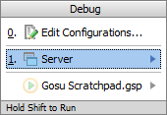
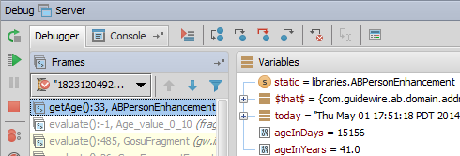
Steps to debug enhancements
Set breakpoints in enhancement Debug Server
ALT+SHIFT+F9
Select Server
Console tab
Verify output reads
Perform actions to hit breakpoint
In Debug tool window, review Debugger
Resume program
F9
*** AppName ready ***
|EOS~032|
Notes:
|EON~032|
<number>

Slide 33
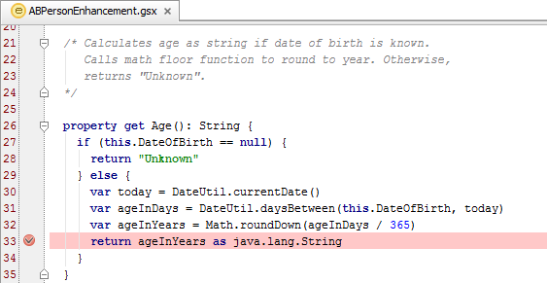
Breakpoints
A breakpoint indicates a place where you want to suspend the execution of Gosu code
|EOS~033|
Notes:
|EON~033|
Because you can step through lines, you normally need only one breakpoint for each section of code you want to investigate.
<number>

Slide 34
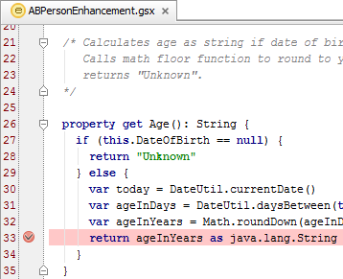
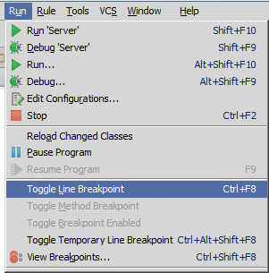
Setting breakpoints
Click in the gutter for the given line
Select line
Main menu → Run → Toggle Line Breakpoint
CTRL+F8
|EOS~034|
Notes:
|EON~034|
You can set a breakpoint by clicking in gutter for the given line in the editor. You can also select the line and then select Main menu → Run → Toggle Line Breakpoint or use the CTRL+F8 keystroke.
<number>

Slide 35
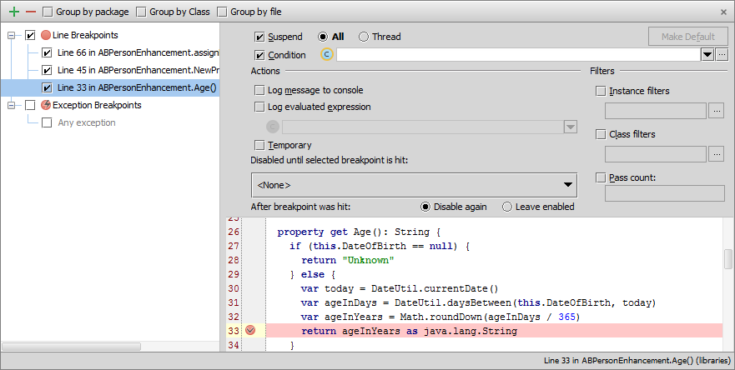
View all breakpoints
Run → View Breakpoints… or CTRL+SHIFT+F8
Enable, disable, define action and conditions
|EOS~035|
Notes:
|EON~035|
In addition to CTRL+SHIFT+F8, right-clicking on the breakpoint also displays a menu with choices to Edit, Disable, Remove, or View Breakpoints. In the slide example, the View Breakpoints dialog shows all the breakpoint options.
The Breakpoint options dialog allows you to review all breakpoints. In the Toolbar, you can add a breakpoint, remove a breakpoint, display breakpoints under their respective packages rather than under their types, display breakpoints under their respective classes, and display breakpoints under their respective files. There are various Breakpoint options to set. You can enable a suspend policy for a breakpoint. For example, for a Thread policy the thread where the breakpoint is hit is suspended. You can also specify a condition in either Gosu or Java. You can also specify actions, such as logging the evaluated expression.
<number>

Slide 36
Debug 'Server'
Start debug Server
ALT+SHIFT+F9
Select Server
Console tab
Verify output reads
*** <GuidewireApplication> ready ***
|EOS~036|
Notes:
|EON~036|
To debug the server, select Main menu → Run → Debug 'Server' or Main menu → Run → Debug… → Server. In the Debug tools window, confirm that the application is running and is ready (***** AppName ready *****).
<number>

Slide 37
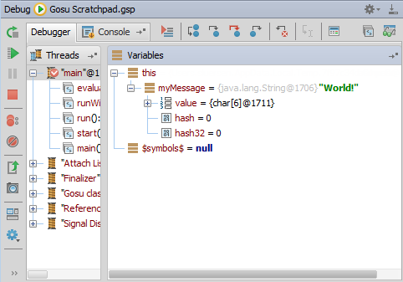
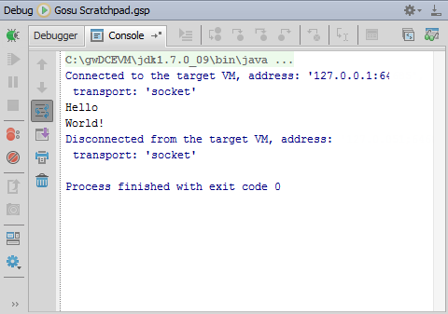
Debug tool window
ALT+5
Opens Debug window
Debugger tab
Rerun, Resume, Pause, Stop
View breakpoints
Step over, into and out
Inspect and watch
Console tab
View output
|EOS~037|
Notes:
|EON~037|
The debugger enables you to execute your application step by step, examine program information related to variables, watches, or threads, and change your program without leaving Guidewire Studio.
<number>

Slide 38
When application hits a breakpoint…
Guidewire Studio suspends code execution
File with breakpoint opens in Studio
Breakpoint line highlighted in blue
Debug tool window opens
Break point file
Debug Tool Window
|EOS~038|
Notes:
|EON~038|
To hit breakpoints, you must run the application in a debug 'server' process.
Because you can step through lines, you normally need only one breakpoint for each section of code you want to investigate. There is no advantage to having breakpoints on multiple consecutive lines because the first breakpoint suspends normal execution and normal execution does not resume until you request it to.
The Frame tab lists the object passed to the code (for enhancements, this is the root entity or class). Variable values at the breakpoint are visible in the Variables window. Frames shows the sequence of actions executed until the breakpoint.
<number>

Slide 39
Stepping through code
Several step tools are available to help in debugging
Step over (F8) advances you to the next line in the file
Step into (F7) advances you to the next line executed
Force step into (Alt+Shift+F7) steps into, ignore stepping filters for libraries, constructors, etc.
Step out(Shift+F8) step to the first line executed after returning from this method
|EOS~039|
Notes:
|EON~039|
Once the debugger pauses execution, you can step through the code in one of several ways. The most basic is to stepping through code one line at a time using Step Over (F8).
<number>

Slide 40
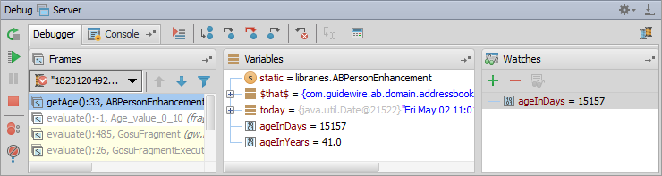
Debugger
For breakpoint, debugger shows how code executes
Debug Gosu code running in the Debug 'Server' process
Class
Enhancement
Rule
|EOS~040|
Notes:
|EON~040|
When the Debug 'Server' process hits a breakpoint in Gosu code, the debugger suspends the normal execution of code until you resume it. When you resume the debugger, code executes as normal until the debugger hits another breakpoint.
<number>

Slide 41
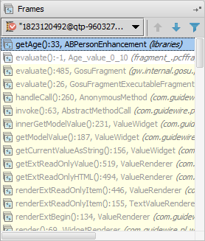
Debugger: Frames pane
Shows list of threads in your application
Select a thread and view the stack frame
Navigate between frames
Navigate to source of frame code
Frame
File Source
|EOS~041|
Notes:
|EON~041|
The Frames pane enables you to gain access to the list of threads running in your application, export threads to a text file, and customize the thread presentation.
For each thread, you can view the stack frame, examine frames, navigate between frames, and automatically jump to the source code of a frame in the editor.
A thread can be chosen via a thread selector drop-down list on top of the pane. The status and type of a thread is indicated by the special icon and textual note next to the thread's name.
To examine the values stored in a frame, use the Variables pane of the Debug tool window.
<number>

Slide 42
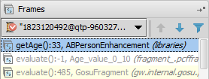
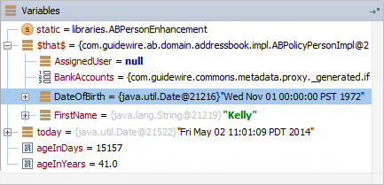
Debugger: Variables pane
Examine variables, fields, arrays, primitive types, and object of a selected frame
Enable Enhance Entities Visualization to view all entity properties
Project Settings → IDE Settings → Guidewire Studio → Debugger Settings
Add variable to watches
Frame
|EOS~042|
Notes:
|EON~042|
When a stack frame is selected in the Frames pane, the Variables pane displays all the data within its scope (method parameters, local and instance variables). In the variables pane you can set labels for the objects, inspect objects, evaluate expressions, add variables to watches and more. You can examine static variables, fields, arrays, primitive types, and objects.
Enable Enhance Entities Visualization in Guidewire Studio to view all entity properties. In Project Settings, in IDE Settings, select Guidewire Studio. Then, in Debugger Settings, check the Enhance Entities Visualization checkbox.
<number>

Slide 43
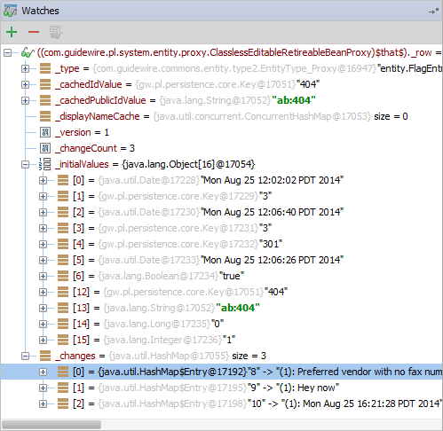
Debugger: Watches pane
A watch is an expression whose value you wish to observe
Click Add → Enter property or expression
Limited to symbol $that$
Drag object or property from the Variable pane to watches pane
|EOS~043|
Notes:
|EON~043|
In the Watches pane you can evaluate any number of variables or expressions in the context of the current stack frame. The values are updated with each step through the application and become visible every time the application is suspended.
The easiest way to populate the Watches pane is to run the code to a desired point, then drag the object or property from the variables to the Watches pane.
IMPORTANT: The default language for the Watches panel is Java. To change the language to Gosu, when debugging at a breakpoint, open the Evaluate Expressions dialog (ALT+F8 or click the Evaluate Expressions icon in the Debugger toolbar). In the Expression field, click the Java icon, then select Gosu in the Choose Language context menu. Click Evaluate and Close. Now, you will be able to add a Watch in the Watches pane that is in the Gosu language.
<number>

Slide 44
Resume debugging
To resume the execution of code…
Main menu → Run → Resume
F9
Or, in the Debug Tool Window, click Resume
Code continues to hitting next breakpoint
|EOS~044|
Notes:
|EON~044|
<number>

Slide 45
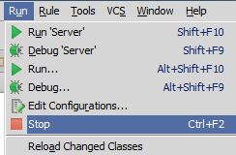
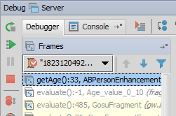
Stopping debug server
To stop the debug server process…
Main menu → Run → Stop
CTRL+F2
Or, in the Debug Tool Window, click Stop
|EOS~045|
Notes:
|EON~045|
<number>

Slide 46
Entity enhancement fundamentals
Creating entity enhancements
Referencing enhancement properties and methods
Debugging enhancements
Gosu enhancements for Java
|EOS~046|
Notes:
|EON~046|
<number>

Slide 47
Gosu enhancements for Java
Write Gosu enhancements for Java types
Useful when creating generic methods that…
Do NOT relate to a specific entity
Extend the functionality of a base data type
Examples:
GWBaseIntegerEnhancement enhances java.lang.Integer
GWBaseDateEnhancement enhances java.util.Date
GWBaseListEnhancement enhances java.util.List
Deploy and debug the same way as other enhancements
|EOS~047|
Notes:
|EON~047|
You call static methods directly from the class itself as opposed to creating an instance of the class.
<number>

Slide 48
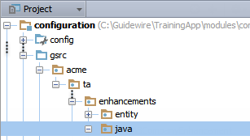
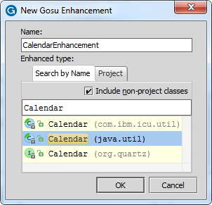
Create enhancement file
In Project View, select a package in …\configuration\gsrc\
Context menu → New → Gosu Enhancement
Enter the file name
TypeName + AdditionalText + Enhancement
Select entity or class
|EOS~048|
Notes:
|EON~048|
For third party APIs, check the Include non-project classes check box in the New Gosu Enahncement checkbox.
Guidewire recommends that you create an enhancement in a custom package named after your company. For example, if you are implementing an application for Acme Insurance, then you would create all custom enhancements in a package named Acme or in sub-packages of an Acme package.
The recommended naming convention for Java Enhancements is <TypeName> + <AdditionalTextWhenNeeded> + Enhancement. In some cases, you may need to have multiple enhancements for a single class. In this case, the <AdditionalTextWhenNeeded> should be used to clarify the difference between the enhancements.
<number>

Slide 49
Create static methods
1 package libraries
2
3 uses gw.api.util.DateUtil 4 5 enhancement CalendarEnhancement: java.util.Calendar { … 9 10 static function isLeapYear(yearToCheck: int): boolean { 11 var FirstDate = "01/01/" + yearToCheck 12 var SecondDate = "01/01/" + ( yearToCheck + 1 ) 13 var DaysBetween = DateUtil.daysBetween( FirstDate as java.util.Date, SecondDate as java.util.Date) 14 return (DaysBetween == 366) 15 } 16 }
Line 5: imports enhancement of the Java Calendar class
Line 10: callsisLeapYear() static function
|EOS~049|
Notes:
|EON~049|
Static methods are not called from instances. Because static methods do not work off an instance, there is no need use the this keyword in a static Gosu enhancement method of a Java class.
<number>

Slide 50
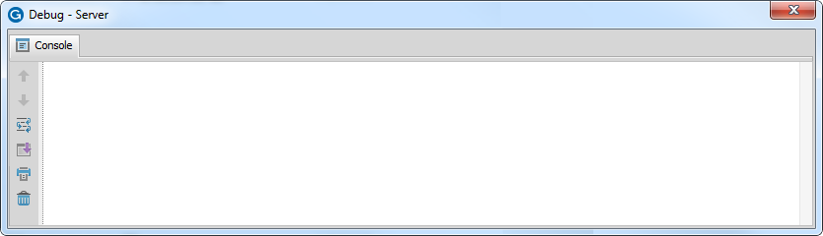
Reference static methods
1 uses java.util.Calendar
2 var output = ""
3 for (i in 2014..2019) {
4 var result = Calendar.isLeapYear(i)
5 output += String.format("Is %s a leap year? %s \n",{i, result})
6 }
7 print(output)
Is 2014 a leap year? false
Is 2015 a leap year? false
Is 2016 a leap year? true
Is 2017 a leap year? false
Is 2018 a leap year? false
Is 2019 a leap year? false
Line 1: Declares full qualified name for Calendar class
Line 4: References the enhancement static function
|EOS~050|
Notes:
|EON~050|
In the slide example, Gosu Scratchpad executes code that references the static method. The code outputs to the console in Studio.
Line 3 declares a loop that iterates through a range of values and instantiates an iterator variable (i).
Line 4 references the isLeapYear() enhancement function for the Java Calendar class. The iterator variable (i) is the argument value for the isLeapYear() static function.
Line 5 concatenates a string using the String.format() function. The function creates a string using the iterator value and the boolean variable.
Line 7 outputs the string to the console.
<number>

Slide 51
Describe the purpose and functionality of Gosu enhancements
Create entity enhancements
Reference entity enhancement properties and methods
Create Gosu enhancements for Java classes and interfaces
Debug enhancements
|EOS~051|
Notes:
|EON~051|
<number>

Slide 52
Where can you create enhancements in a project?
What type of logic does a getter implement? A setter? A method?
When you create a new enhancement, what code does Studio add for you automatically?
For an enhancement on the ABContact entity, what code would you write to reference the given ABContact's AssignedUser field?
How do you create an enhancement method that returns no value?
How do you reference enhancement properties and methods?
|EOS~052|
Notes:
|EON~052|
Answers
1) Create enhancements in an Guidewire application project in Guidewire Studio in …\configuration\gsrc\.
2) Getter: Logic that returns a derived value and does not take parameters or change other data. Setter: Logic that takes a single input value and uses that to modify some other field or set of fields on the given object. Method: Logic that requires parameters, changes data, or otherwise does more than simply deriving or setting a value.
3) Studio automatically creates the package statement and the enhancement declaration statement and the type reference.
4) this.AssignedUser
5) You would create the method and optionally specify a return type of void.
6) You reference enhancement properties and methods using the same syntax as base application entity properties and methods: object.propertyOrMethodName.
<number>

Slide 53
|EOS~053|
Notes:
|EON~053|
<number>

